Slide 1


Session // 01 INTRODUCTION TO PYTORCH FACULTY OF SCIENCE AND ENGINEERING +++
Diego Corona Lopez – AI Technical Specialist

Slide 2

Agenda
PyTorch fundamentals and advantages
Working with tensors
Tensor operations and manipulation
Automatic differentiation (Autograd)
Moving from data to tensors
GPU acceleration

Slide 3

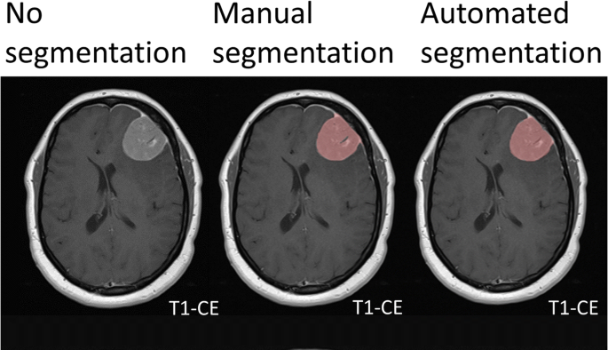
Introduction
Deep Learning is a subset of machine learning where models — typically neural networks — learn directly from data.Inspired by the structure and function of the human brain. Just like humans learn to recognize cats by seeing many pictures of cats, deep learning models learn patterns from data — not rules programmed by hand.

Slide 4
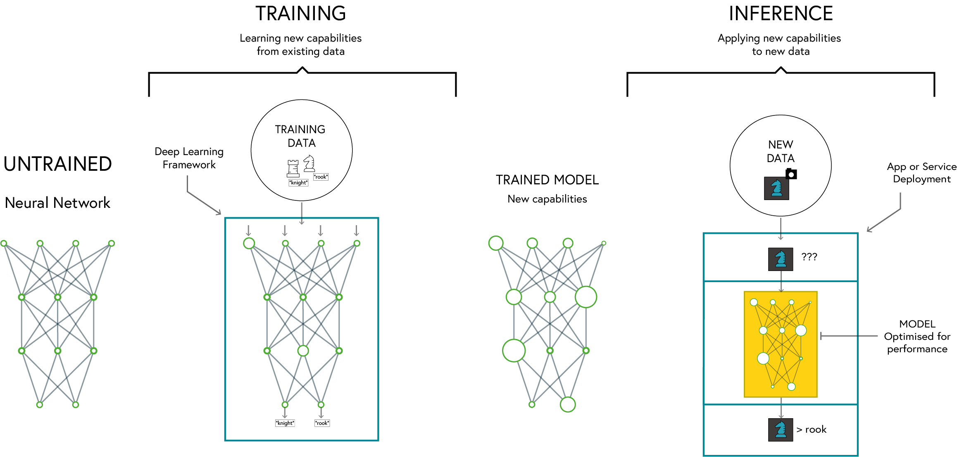
Deep learning

Slide 5

PyTorch
Dynamic Computation Graph: Easier debugging and flexible model building
Pythonic and Intuitive API: Seamless integration with Python libraries
Strong Research and Industry Adoption: Used by major companies and researchers
Excellent GPU Acceleration: Optimised for performance on GPUs and TPUs
SE01
05

Slide 6
Why PYTORCH
Feature | PyTorch | TensorFlow | Keras
Ease of Use | High (Pythonic, dynamic computation graph) | Moderate (Static graph by default, more setup) | Very High (High-level API)
Flexibility | High | Moderate | Low (abstracted API)
Performance | High | Very High (Optimized for deployment) | Moderate
Debugging | Easy (Eager execution) | Harder (Graph-based execution) | Easy
GPU Support | Excellent | Excellent | Good
Industry Use | Research, Prototyping | Production, Deployment | Rapid Prototyping

Slide 7
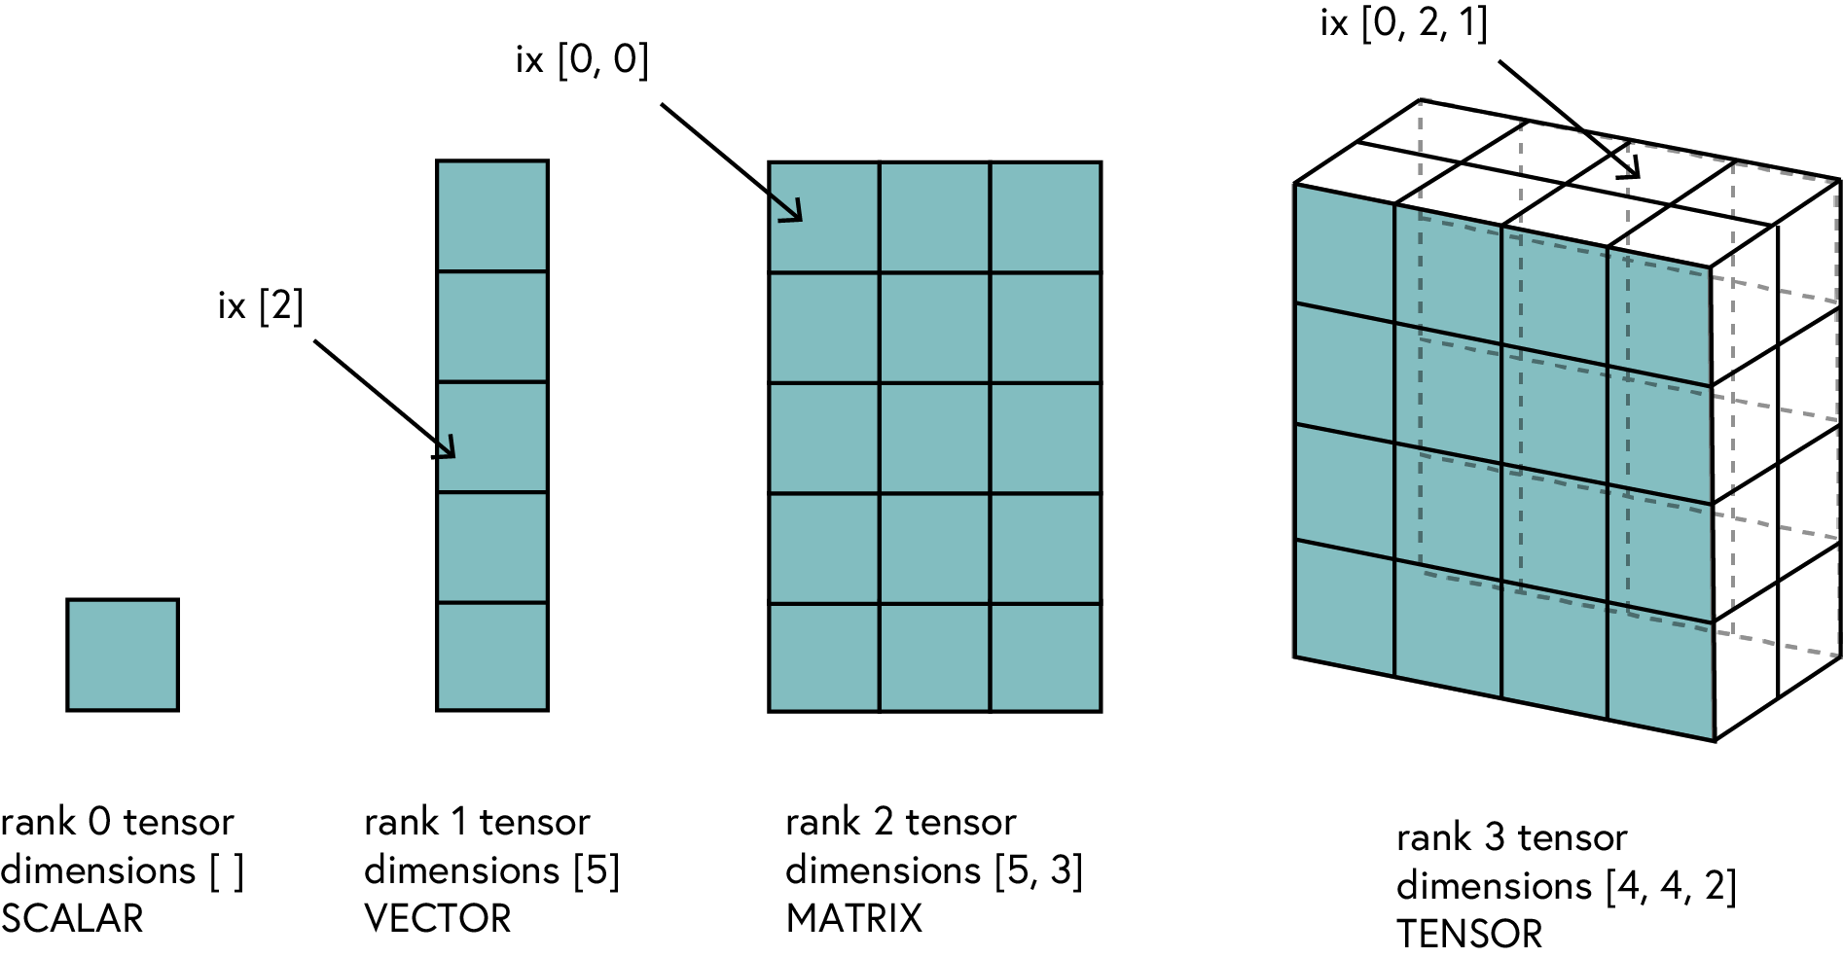
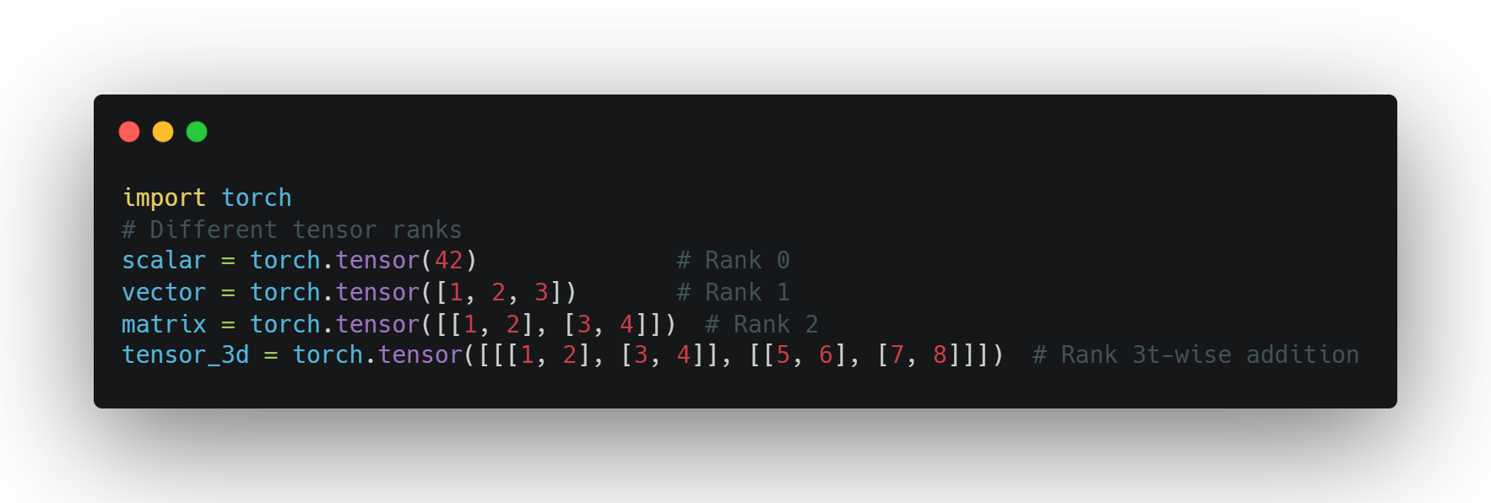
Tensors
Definition: A generalization of vectors and matrices to higher dimensions
Why Tensors?
Efficient representation of multi-dimensional data
Optimized for computation (CPU & GPU)
SE01
07

Slide 8
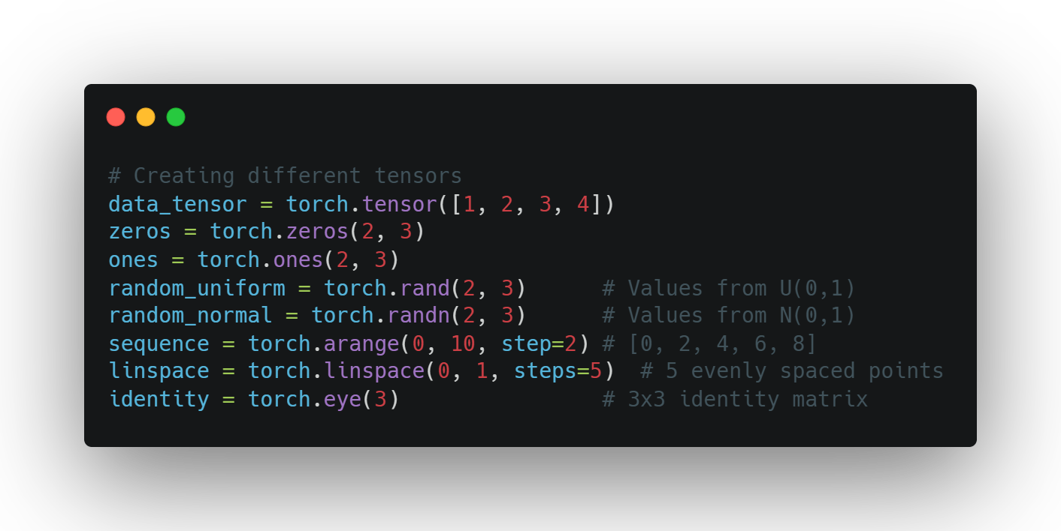
Creating Tensors
Basic Tensor Creation Methods
torch.tensor() - from existing data
torch.zeros(), torch.ones() - filled tensors
torch.rand(), torch.randn() - random tensors
torch.arange(), torch.linspace() - sequences
torch.eye() - identity matrices
Data types can be specified with dtype parameter
SE01
08

Slide 9
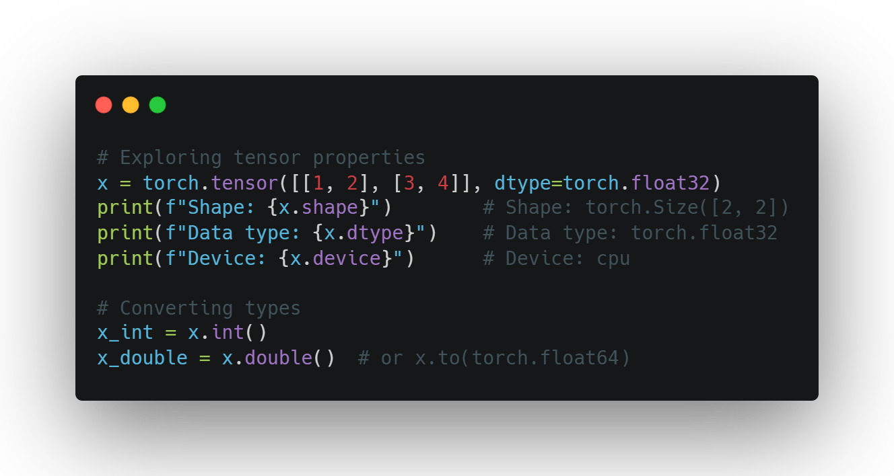
TENSOR
PROPERTIES
Working with Tensor Attributes
Shape: tensor.shape
Data type: tensor.dtype
Device: tensor.device
Accessing values: tensor.item() for scalars
Converting types: tensor.float(), tensor.int()
SE01
09

Slide 10
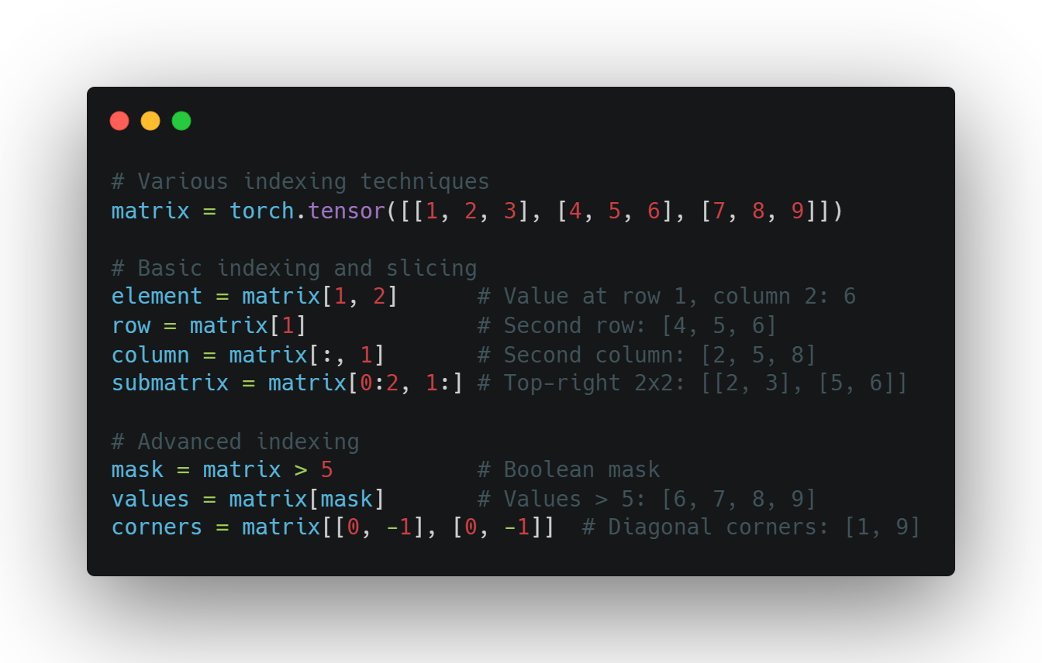
TENSOR
indexing
Accessing Tensor Data
Basic indexing: tensor[i, j]
Slicing: tensor[1:3]
Advanced indexing techniques:
Boolean masks: tensor[tensor > 0]
Negative indexing: tensor[-1] (last element)
Using ellipsis: tensor[..., 0]
SE01
10

Slide 11
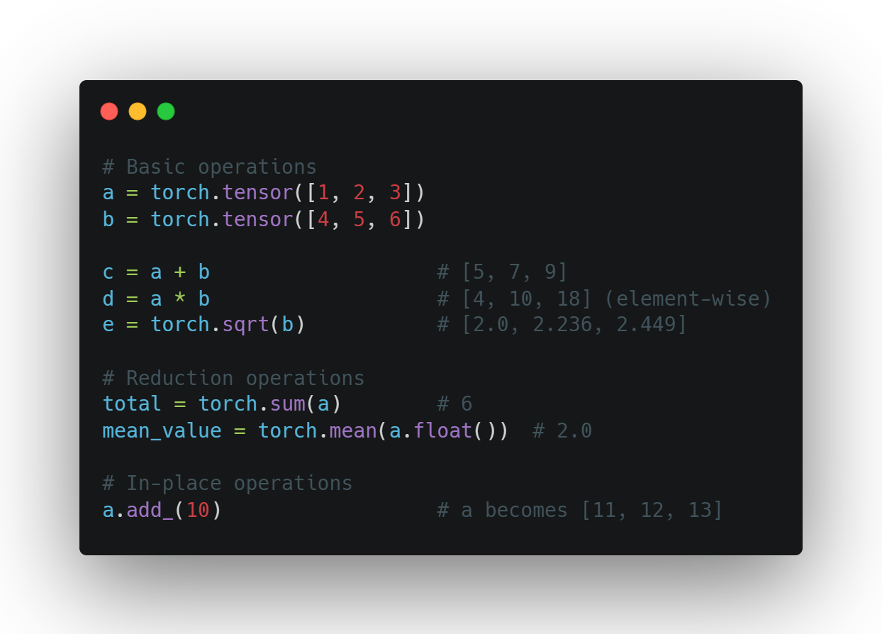
BASIC TENSOR
OPERATIONS
Common Operations
Arithmetic: +, -, *, /
Element-wise operations: torch.sqrt(), torch.pow()
Reduction: torch.sum(), torch.mean()
Comparisons: >, <, ==
In-place operations: tensor.add_(1) (note the underscore)
SE01
11

Slide 12
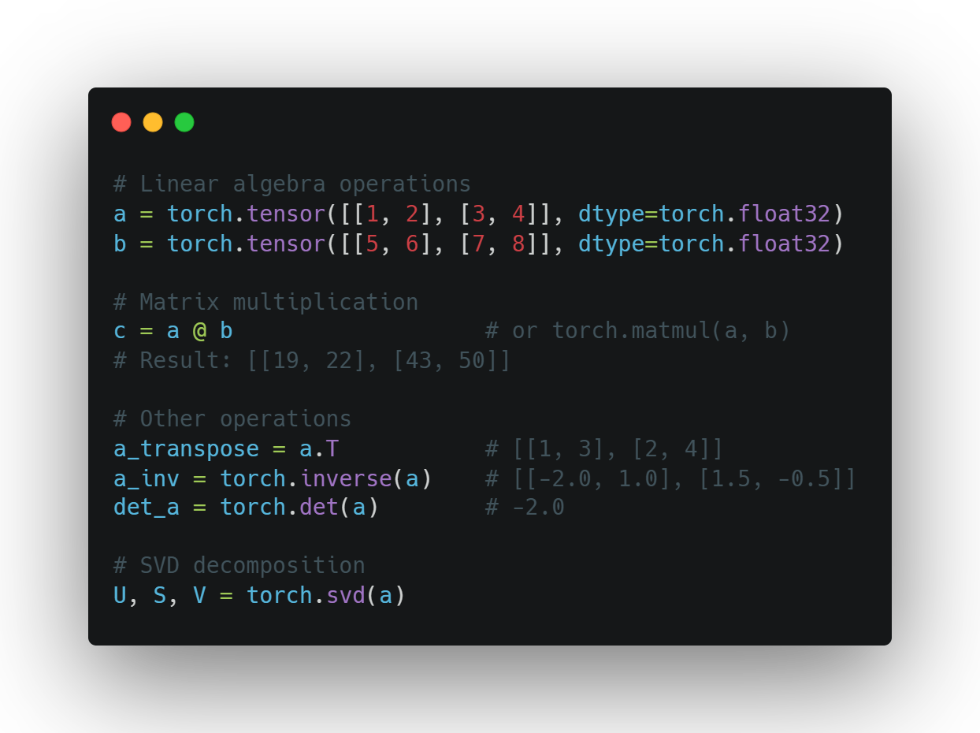
MATRIX
OPERATIONS
Linear Algebra with PyTorch
Matrix multiplication: @ or torch.matmul()
Transposition: .T or torch.transpose()
Inverse: torch.inverse()
Determinant: torch.det()
Eigenvalues: torch.eig()
SVD: torch.svd()
SE01
12

Slide 13
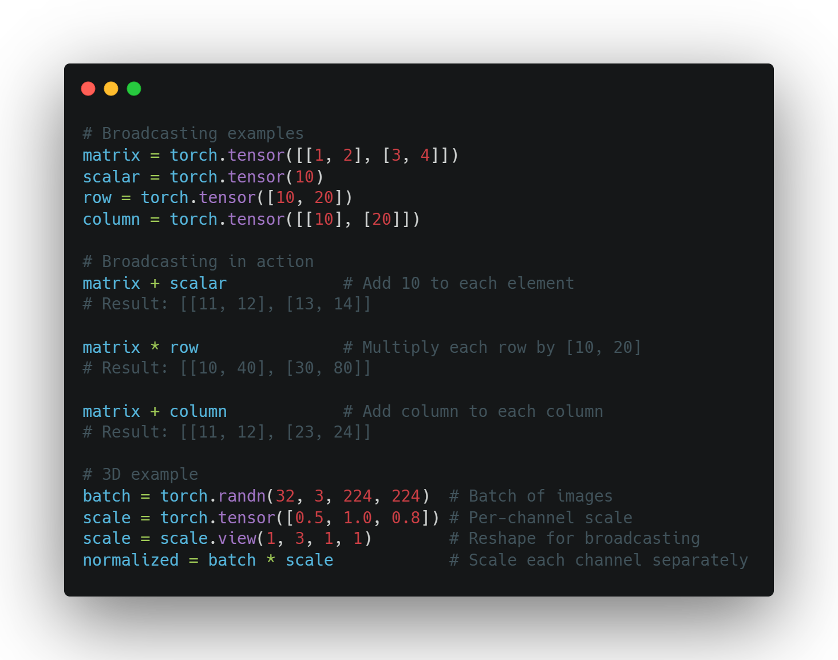
Broadcasting
Working with Different Shapes
Automatic expansion of smaller tensors
Rules follow NumPy broadcasting
Eliminates need for explicit reshaping
Examples:
Add scalar to matrix
Multiply matrix by row/column vector
Scale batches of data
Powerful but requires understanding
SE01
13

Slide 14
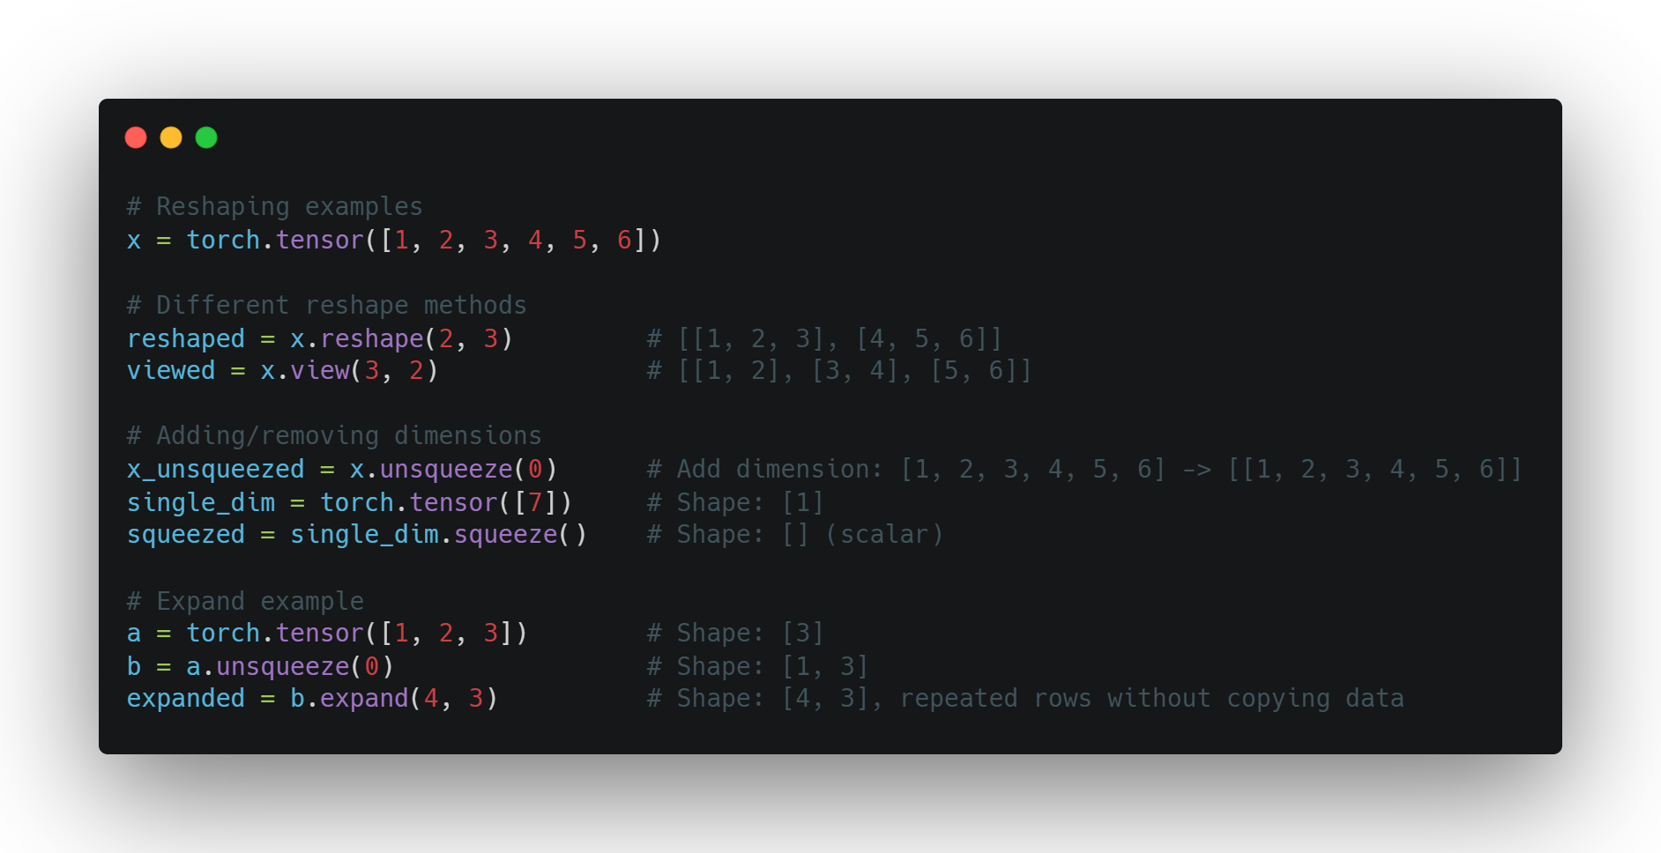
RESHAPING
Changing Tensor Dimensions
reshape() - new shape, possibly new memory
view() - new shape, same memory (must be contiguous)
squeeze() - remove dimensions of size 1
unsqueeze() - add dimension of size 1
expand() - broadcast dimensions without copying
SE01
14

Slide 15
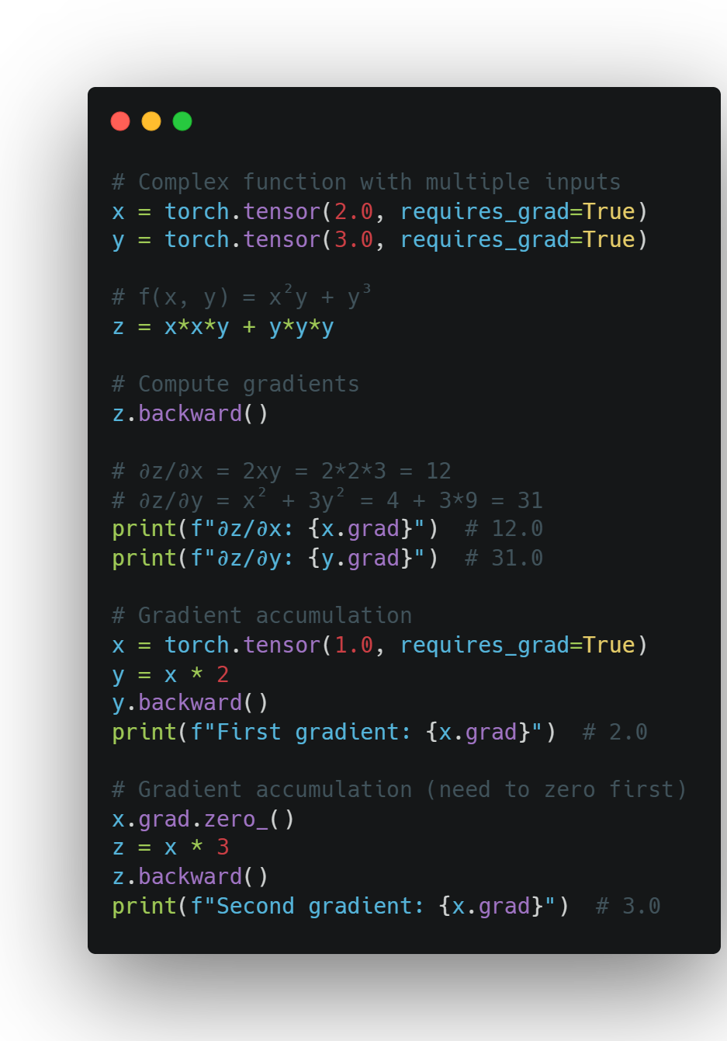
Using autograd
Computing Gradients
Enable tracking with requires_grad=True
Build computation graph through operations
Call backward() to compute gradients
Access gradients via tensor.grad
SE01
15

Slide 16
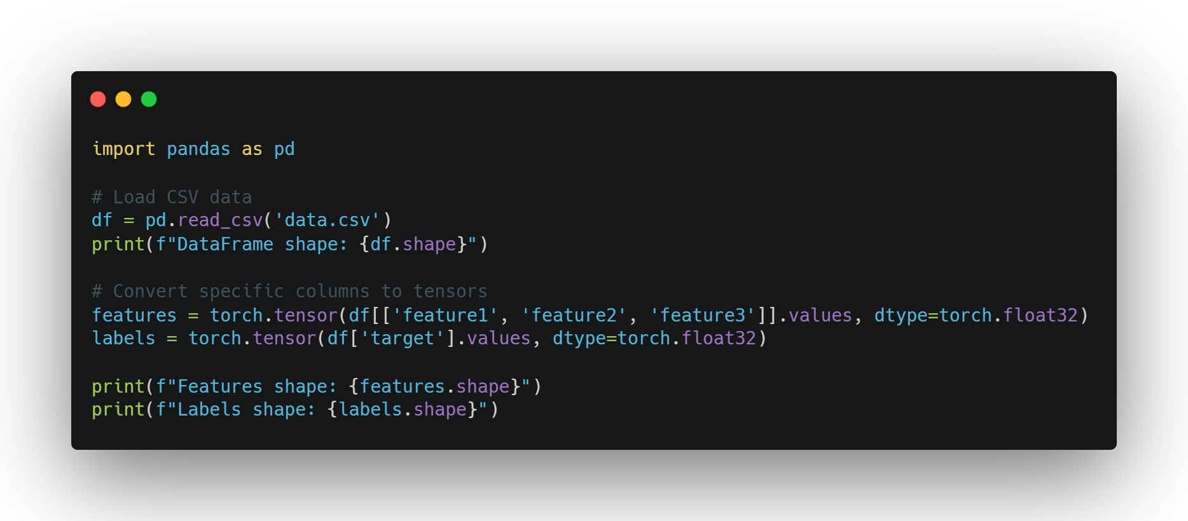
LOADING DATA
From Raw Data to Tensors
Common data sources: CSV, images, text
Using pandas to load structured data
Converting to tensors:
df = pd.read_csv('data.csv')
tensor = torch.tensor(df.values)
DataFrames as an intermediate representation
SE01
16

Slide 17
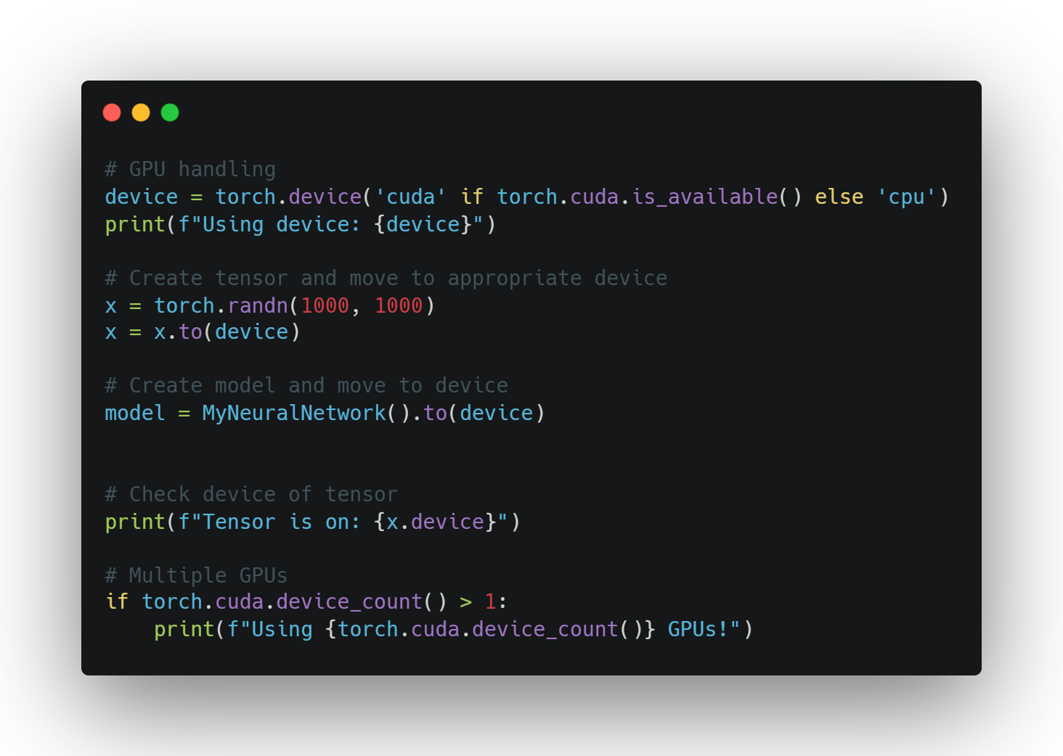
Using
The gpu
Leveraging Hardware
Check availability: torch.cuda.is_available()
Select device: device = torch.device('cuda')
Move tensors to device: tensor = tensor.to(device)
When to use GPU:
Large tensors/datasets
Computationally expensive operations
Deep learning model training
Keep all tensors on same device for efficiency
SE01
17

Slide 18
BEST PRACTICES
Match tensor types before operations
Understand broadcasting rules
Use in-place operations when appropriate
Keep track of your tensor devices
Leverage PyTorch's documentation
Experiment and debug with small examples first

